Slide 1
Autonomous Car
Senior Design II
The Engineers:
Christian Alcalde, Eric Fong, Abdullah Wardak
Notes:
Requirements:
Motivation--why did you build it and what does your project do.
Top level block diagram--be sure to describe architecture and function of sub blocks.
Schematic--need to relate groups of parts in the schematic to the block diagram.
You must discuss the errors that you discovered and how you fixed them (or ignored them).
Layout--Need to discuss the layout and its relation to schematic.
You must discuss errors that you discovered here too and how they were fixed.
Did you respin the board? If so, you should show two layouts.
Software--what did you get working, what did not work?
Milestones--how far along did you get with the components?
Reach goals--what is necessary to complete your reach goals or did you reach them?
Conclusions--this should discuss further work, lessons learned, etc.

Slide 2
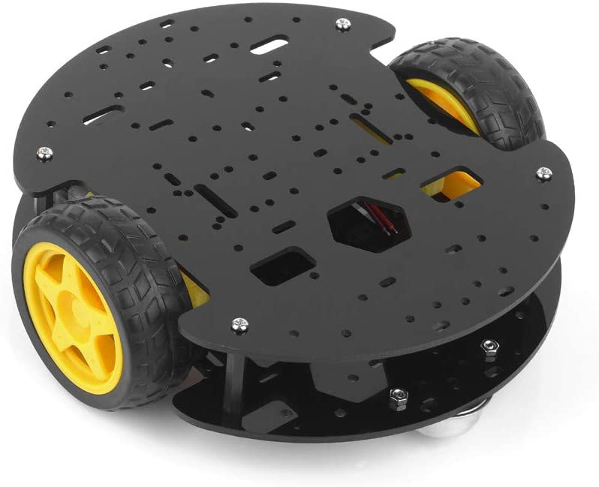
Motivation
Wanted to mimic the new autonomous technologies currently being developed by companies such as Tesla
Inspired to create our own version of a car on a much smaller scale
A computer-controlled car that can navigate a manually designated path
Car will monitor environmental feedback using infrared reflective sensors (IR), ultrasonic proximity sensors, and an inertial measurement unit (IMU)
Data collected from these components will be used for several things:
Controlling the motors
Circumnavigating obstacles
Data collection (travel log)
CA

Slide 3
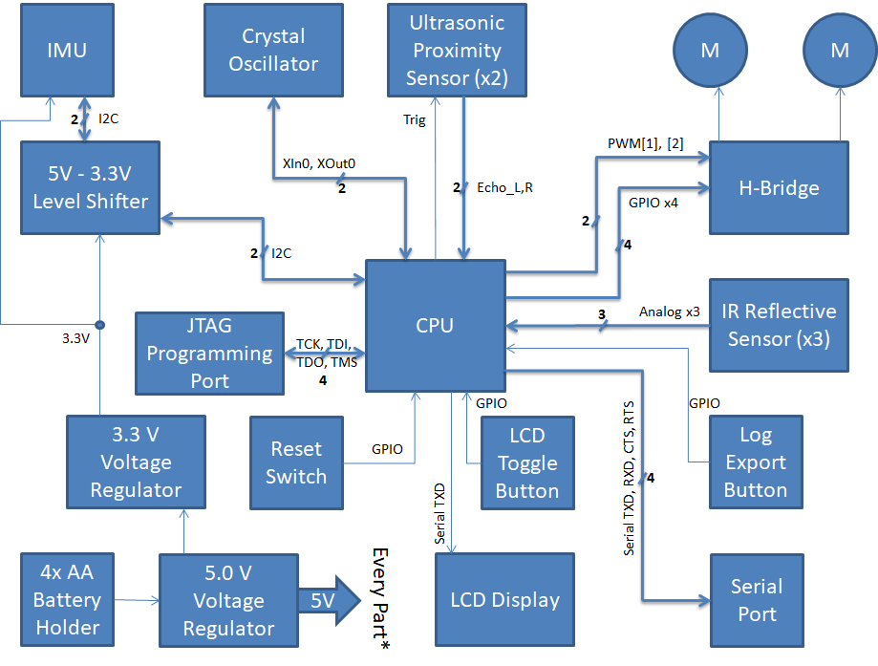
Block Diagram
EF

Slide 4
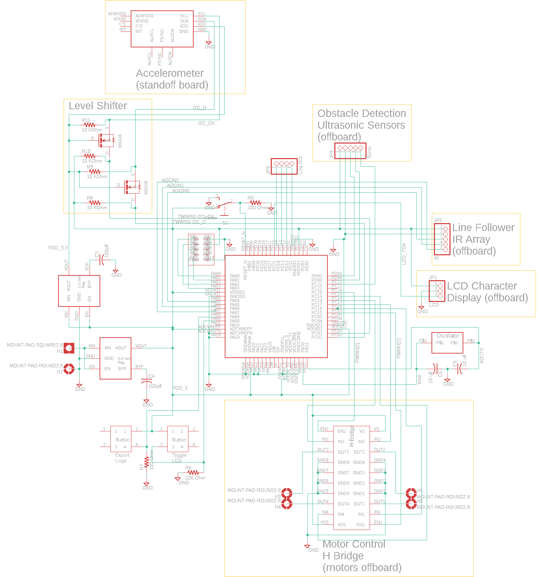
Schematic

Slide 5
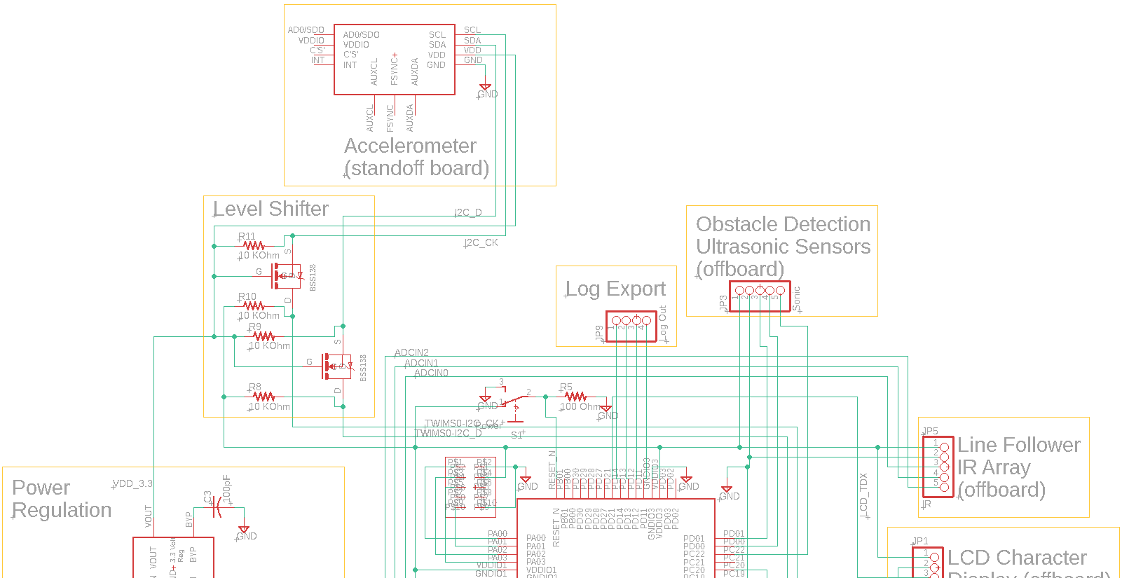

Slide 6
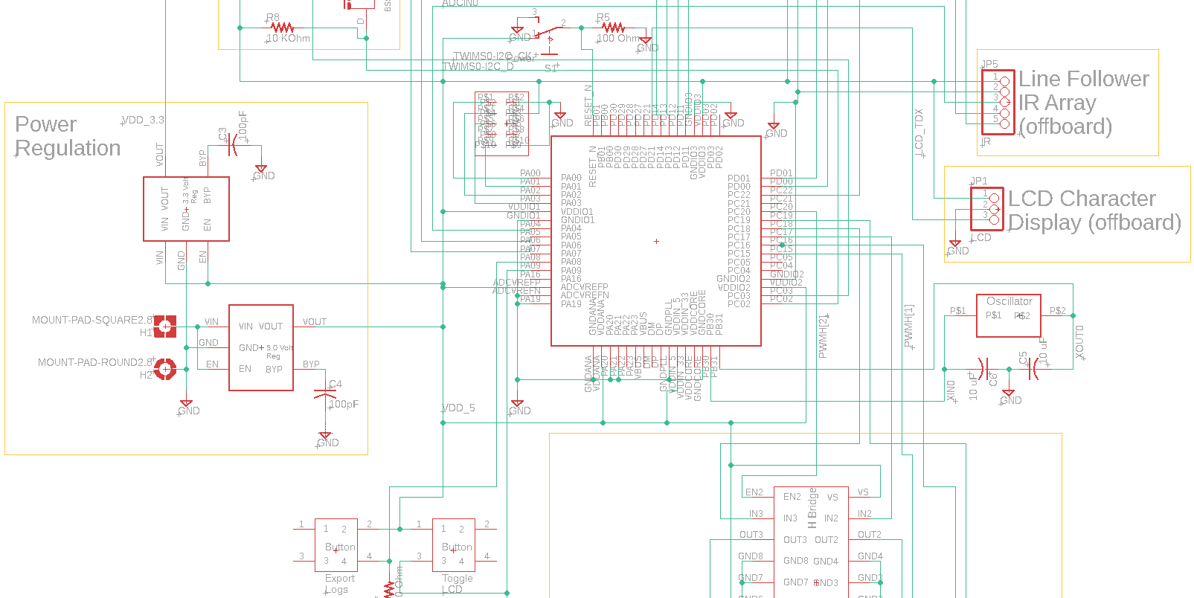

Slide 7
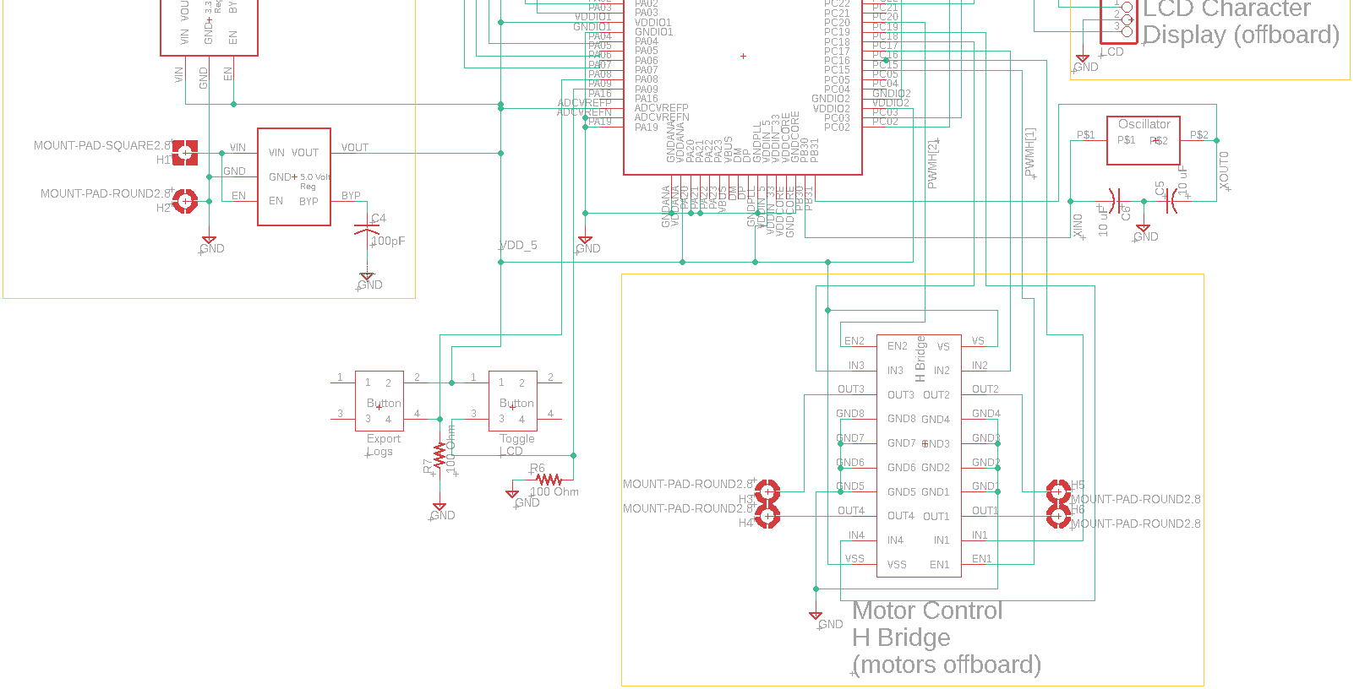

Slide 8
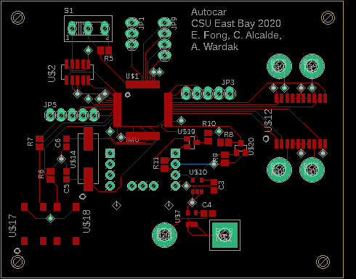
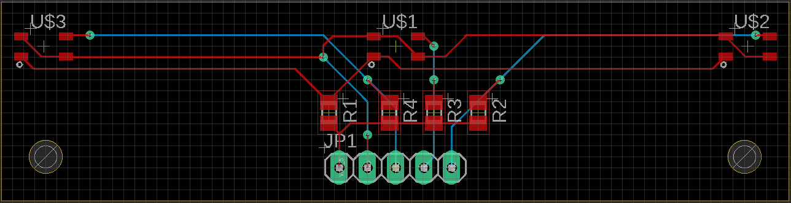
Main PCB and IR Bumper Board

Slide 9
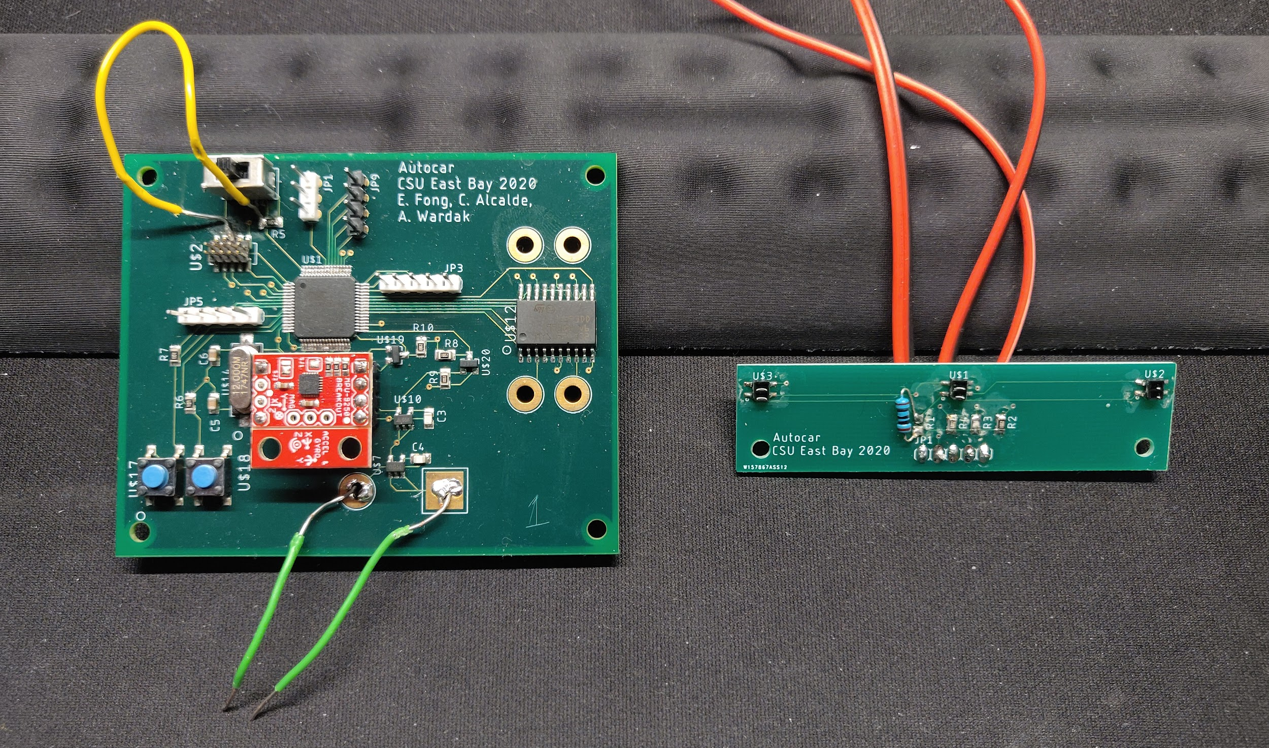
Final PCB Board
IR sensors soldered
IMU module soldered

Slide 10
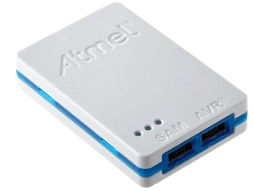
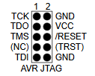

CPU Programmer
Atmel Studio 7
IDE to program the AT32UC3C2512C-A2UT-ND
Allows us to program and debug code for the car
Will be using the Atmel-ICE Basic JTAG Programmer
Using a Micro B cable to connect the programmer and computer
Connects to our board through a 2x5 male pin header
Did not use (NC), (TRST), or /RESET pins
Unforeseen circumstances led to programming problems
Will be explained in later slides
CA

Slide 11
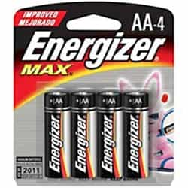
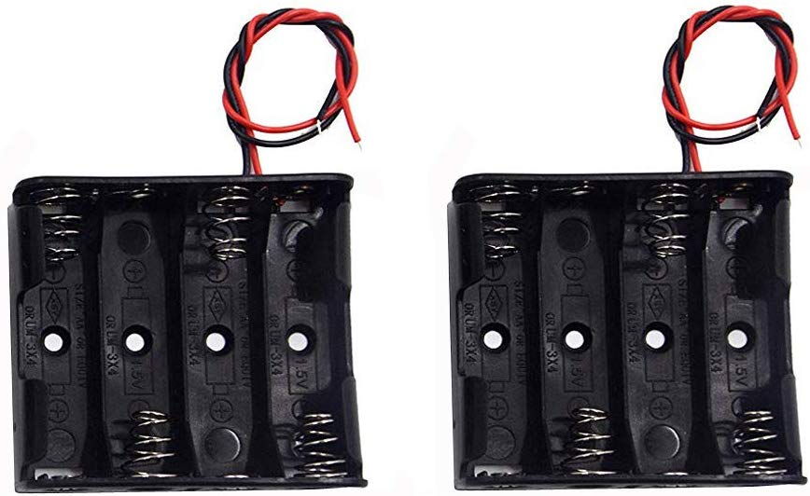
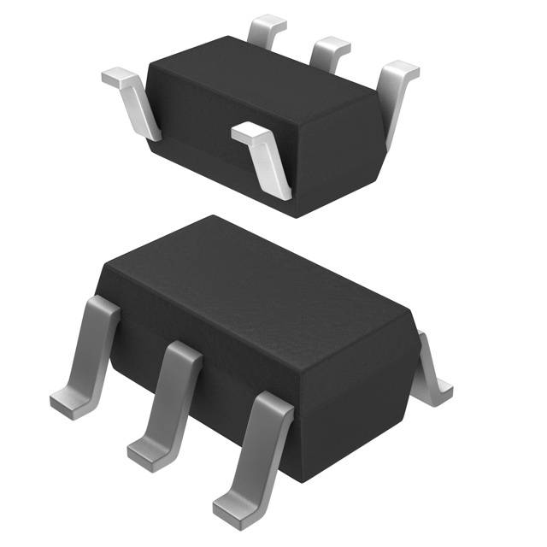
Power
Most of our peripherals run at 5V
4 AA battery holder 6V
Each AA battery = 1.5V
Our board cannot run on 6V
We need two voltage regulators, 3.3V and 5V
AP2210K-3.3TRG1 and AP2210K-5.0TRG1
3.3V Regulator
Powers the SparkFun Inertial Measurement Unit (Accelerometer)
5V Regulator
Converts 6V from battery pack
Powers the CPU and the rest of our components
Feeds into the 3.3V Regulator

Slide 12
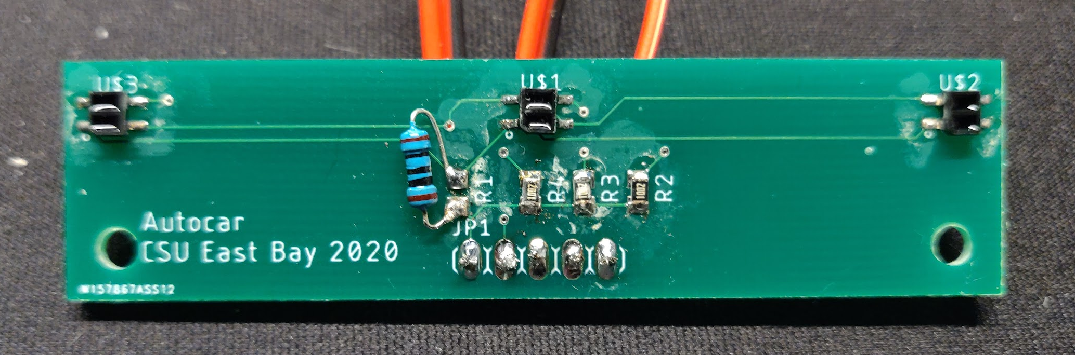
IR Bumper Board
Part of the Line Follower subsystem
3 IR sensors (Part #: QRE1113GR) will allow the car to read the blue tape line and follow it
Sensors placed side by side
The outermost sensors should detect brighter surfaces while the center one should read the darker tape line
Right and left turns will triggered by the outermost sensors detecting lower IR reflection
The IR sensors have a somewhat limited range of < 1 mm
AW

Slide 13
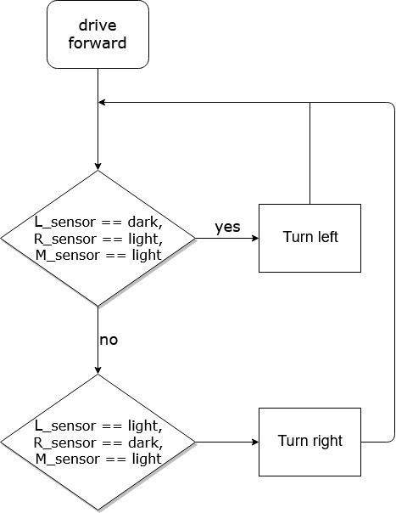
Line Tape Follower Algorithm
Path following with blue painter’s tape using one single tape to make the track
Detecting right or left turn in track:
while(!endOfTravel) { if (L_sensor == dark) turnLeft(); else if (R_sensor == dark) turnRight(); else driveForward(); }

Slide 14
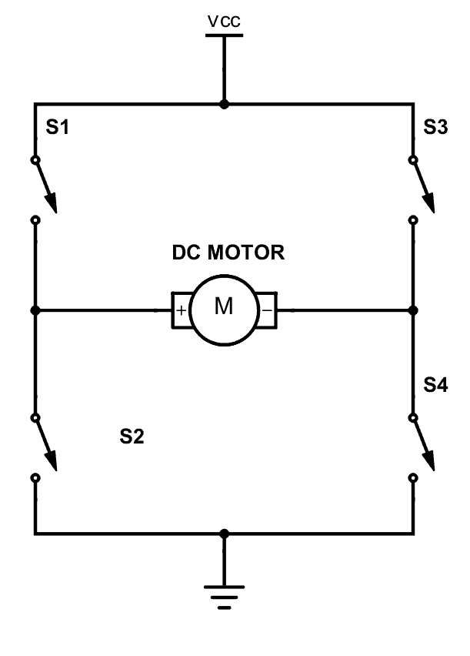
Motor Control
Components: CPU, H-bridge, motors (x2)
Motor speed and direction controlled through H-Bridge (L293DD)
The L293DD has inputs: Enable1, Enable2
If we toggle the enable signals with a frequency in the KHz range, we get an ‘average’ voltage that’s less than Vs
The protocol that handles this rapid toggling is PWM
Controlled, variable motor speed is achieved using Pulse Width Modulation (PWM)
The ‘average on-time’ is referred to as a ‘duty cycle,’ i.e. a duty cycle of 70% with a 5 V Vs should result in an ‘average’ Voltage of 3.5 V
EF

Slide 15


Slide 16
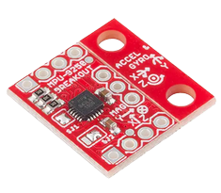
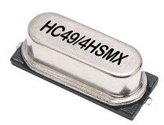
Inertial Measurement Unit (IMU)
SparkFun Electronics SEN-13762
Has three 16-bit ADCs for digitizing accelerometer outputs
Data is communicated over the I²C protocol
Operates on 3.3 V logic
Level shifter needed to communicate with the 5V CPU
Can use this one module to obtain data on acceleration, velocity and position using integration
Acceleration data comes in as a list of measurements, so to integrate this we need to use Riemann Sums
Needs crystal oscillator combined with two 10pF capacitors in parallel connected to CPU
Necessary for accurate positional data calculation
Since we used off-the-shelf microcontrollers, we did not need to use the crystal oscillator of our PCB

Slide 17
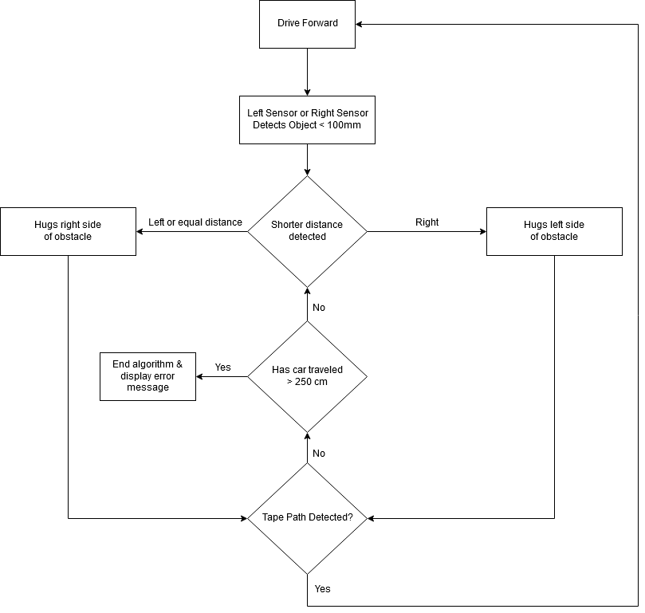
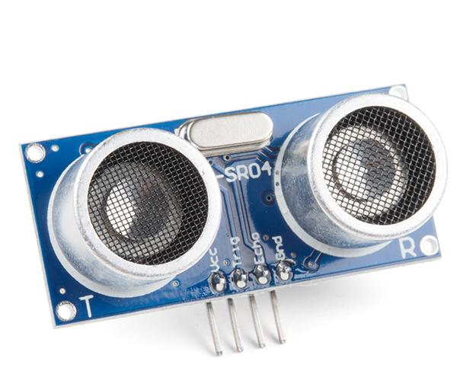
Obstacle Detection
Circumnavigation Flow Chart
Subsystem utilizes the CPU and ultrasonic sensors
Compare distances between two sensors (HC-SR04)
Car moves in direction of shorter distance
Car will “hug” an obstacle until it detects the tape path again or exceeds 250 cm
Sensors detect distance of ~215 mm away and always maintains that distance
When a sensor detects a drop in distance, the motor furthest from the object turns the car to maintain that distance
CA
Notes:
Circumnavigation Algorithm Constraints:
Assume obstacles are no larger than 60 cm x 60 cm
Algorithm ends if car travels more than 250 cm

Slide 18
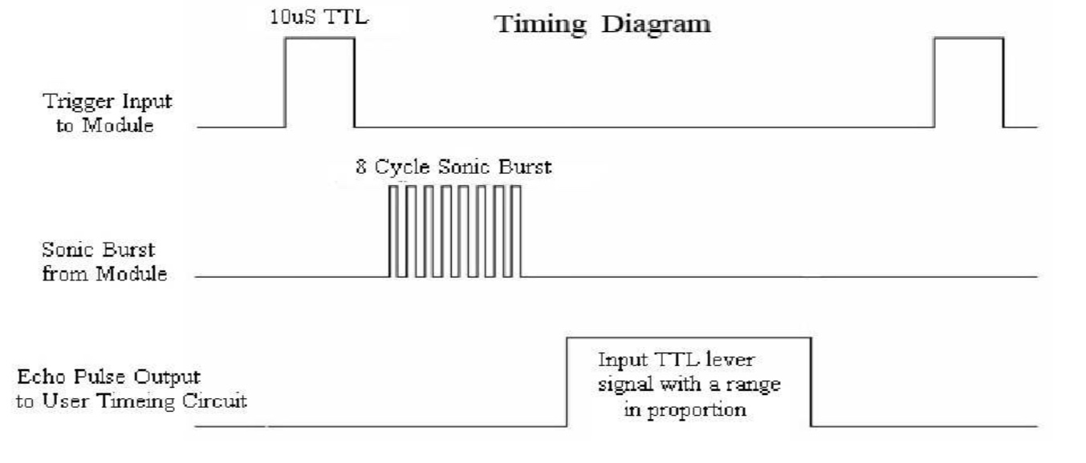
How does the sensor work?
Custom communication protocol using TRIG and ECHO
Sends out eight 40kHz signals and detects a pulse signal back
Used for our car’s obstacle detection
If CPU receives signal indicating obstruction less than 100 mm
Car will activate circumnavigation system
Distance Formula:
Distance = (Time *(340 m/s) )/2

Slide 19
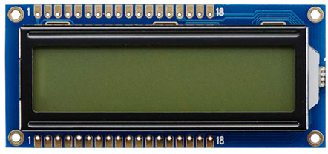
LCD Character Display
16x2 LCD character display
Receives data from CPU over a serial connection
Info to show on the display
Total distance traveled from start, average speed, average acceleration, etc.
Will need to calculate some of these values from the acceleration-velocity-position data
The corresponding push button will be used to cycle through which statistic is displayed
Implementation with an Arduino Uno used the character display to show the ultrasonic distance sensor readings simultaneously

Slide 20
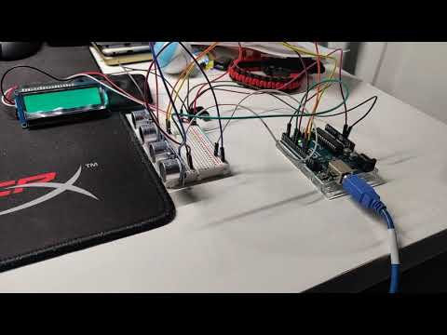

Slide 21
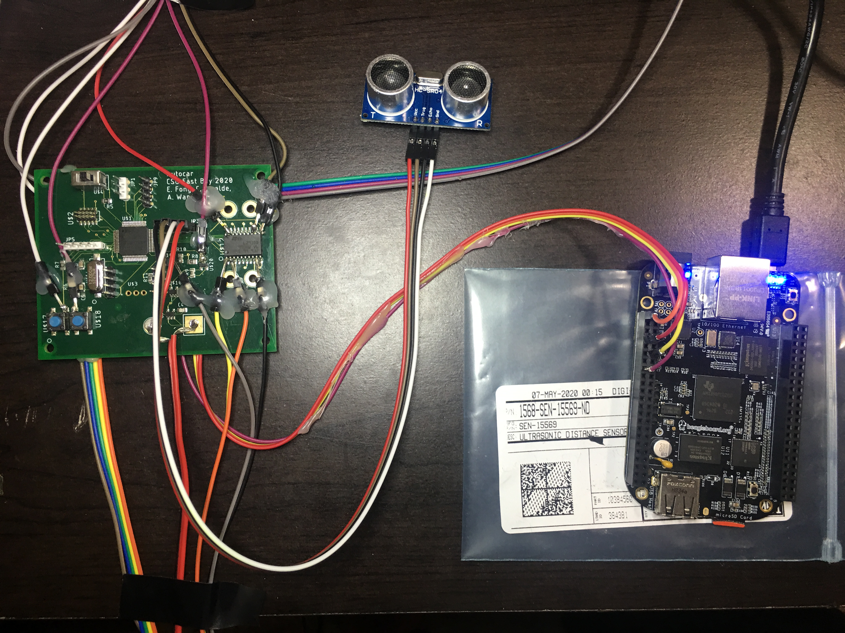
BeagleBone Black Implementation
Ultrasonic Sensor is connected to PCB
PCB is connected to Beaglebone
Beaglebone is connected to laptop
All soldered wires were checked with a multimeter
Checked different resistances
AW

Slide 22
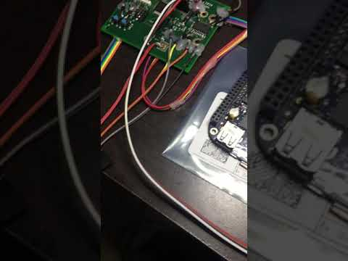

Slide 23
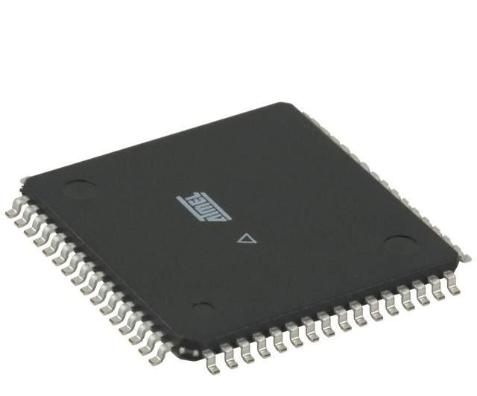
CPU
AT32UC3C2512C-A2UT-ND
32-bit AVR microcontroller
Operating Voltage of 3.3 V to 5 V
We provided a regulated voltage of 5V
64 pins, 45 pins which can be used as GPIO
Built-in floating point processing unit
Useful for IMU calculations
IMU communicates with CPU over I²C
Four PWM channels
Implementing analog voltage control using digital signaling
I²C compatibility
Serial Connections on UART/USART
Programmable through JTAG
Joint Test Action Group
DID NOT WORK OUT SO WELL FOR OUR GROUP

Slide 24
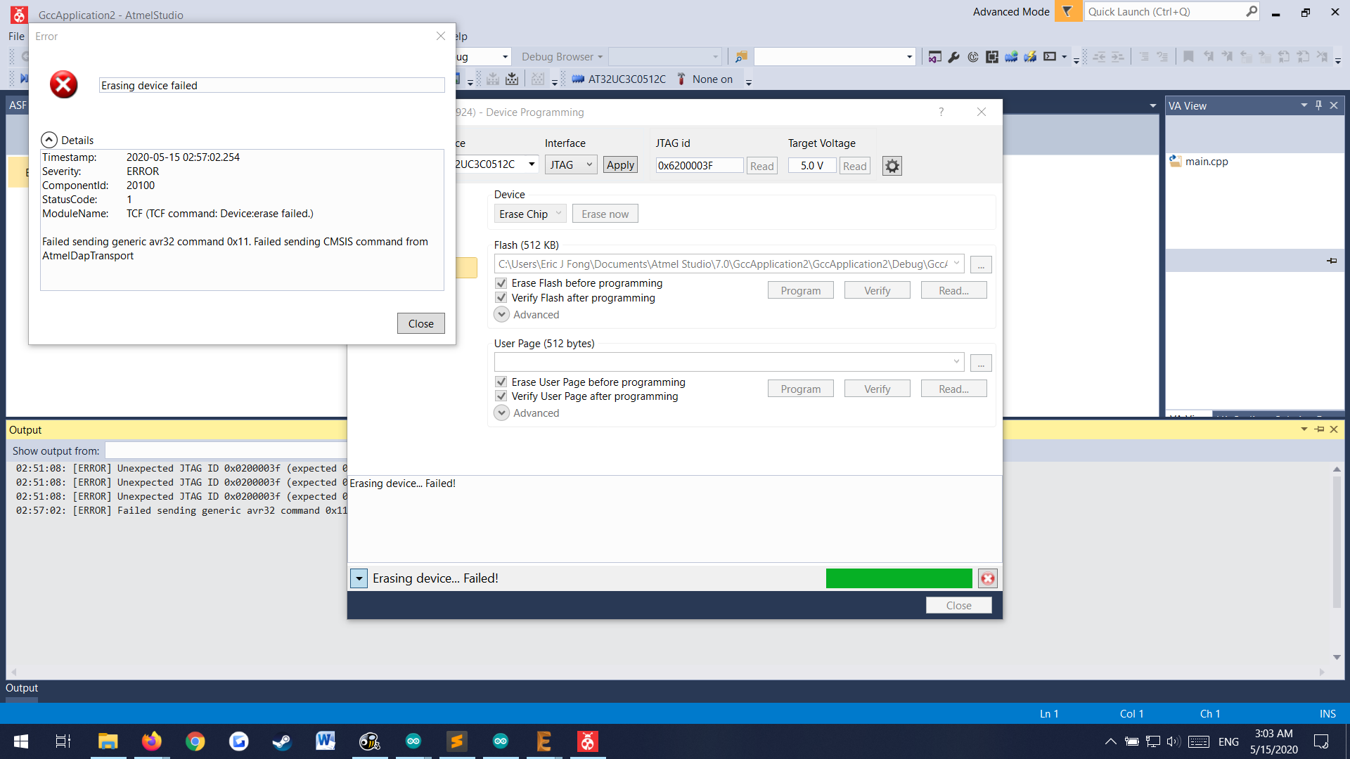
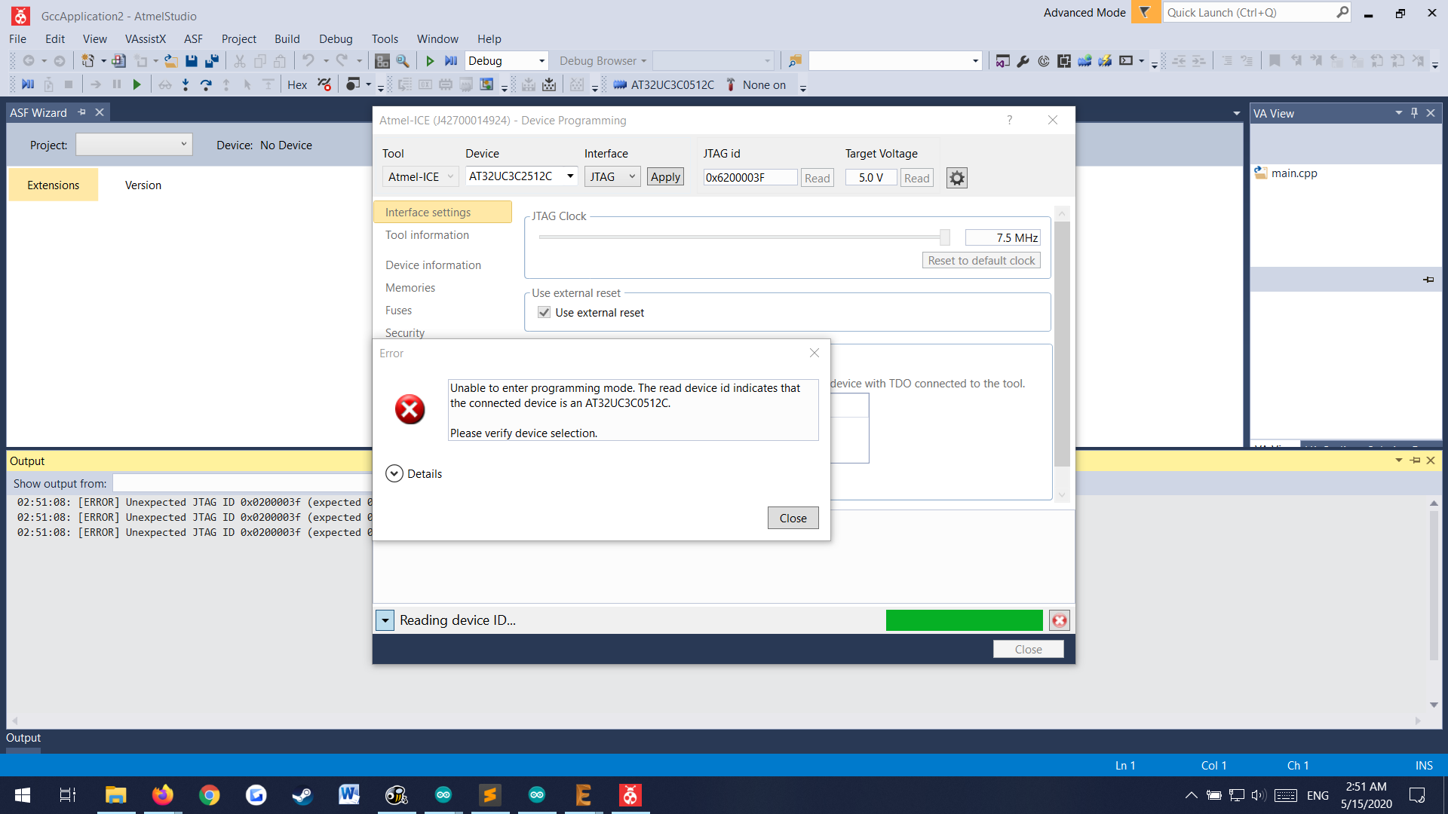
Problems with the CPU
The programmer/Atmel Studio 7 detected the CPU as a ‘AT32UC3C0512C’ instead of the actual part ‘AT32UC3C2512C’
Errors when trying to clear the memory/program the device
Trying to reset the security bit to allow device programming returned failure errors
Unable to respin our board → COVID-19
Forced to provide “proof of concept” prototypes using available microcontrollers
Need image of error message here

Slide 25
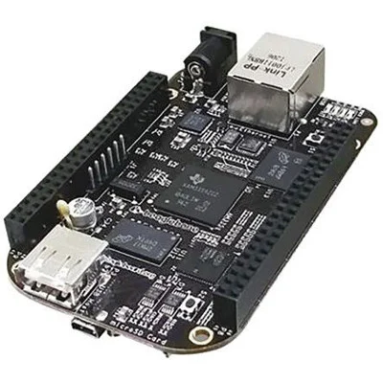
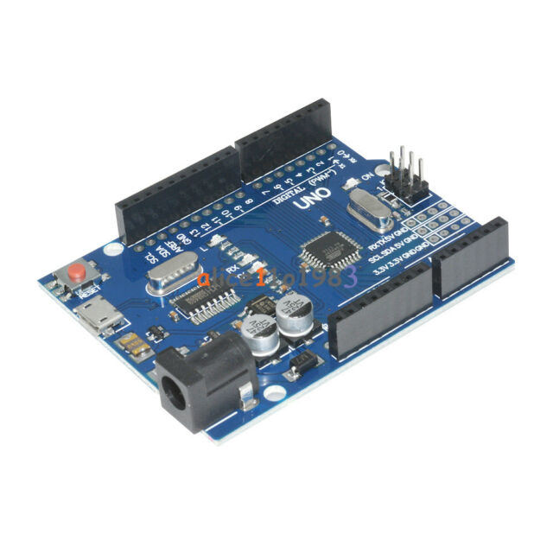
Beaglebone and Arduino
Due to the problem with our PCB processor, our group substituted our PCB’s CPU with a Beaglebone Black or Arduino Uno
Originally proposed idea to cut out processor and rewire board to a microcontroller
Too tedious, lots of room for error, and only one person had a soldering kit
Tried our best to get around this
Not recommended to hand-off parts between group members
Only handed off parts once so that everybody had a main PCB and IR Bumper board
Implemented the subsystems we could using our available resources
Had to pay out of pocket for extra components
CA

Slide 26
Working with what we have
Only able to power up our original PCB (Milestone #1)
CPU problem prevented us from moving on to additional milestones
Lack of extra components made it hard to implement other subsystems
Instead of Atmel Studios 7, had to use different software
Arduino Uno → Arduino IDE
BeagleBone Black → Adafruit Python API/Cloud 9 IDE
Several drivers made for Arduino Uno/BeagleBone Black
Joined ultrasonic sensors and LCD display
H-bridge and motor control drivers written
IR Bumper Array drivers written
Obviously, reach goals were not obtained
Log exporting
Advanced obstacle reaction
Notes:
Requirements:
Motivation--why did you build it and what does your project do.
Top level block diagram--be sure to describe architecture and function of sub blocks.
Schematic--need to relate groups of parts in the schematic to the block diagram.
You must discuss the errors that you discovered and how you fixed them (or ignored them).
Layout--Need to discuss the layout and its relation to schematic.
You must discuss errors that you discovered here too and how they were fixed.
Did you respin the board? If so, you should show two layouts.
Software--what did you get working, what did not work?
Milestones--how far along did you get with the components?
Reach goals--what is necessary to complete your reach goals or did you reach them?
Conclusions--this should discuss further work, lessons learned, etc.

Slide 27
Problems
Solutions
Covid-19: social distancing + limited quantities of hardware
PCB’s processor
IR sensors
It was not for the application that we wanted to use
It is for 1mm distance
Installation of the beaglebone drivers
64-bit Drivers for windows
Work individually using available hardware
Cut out the processor and use Beaglebone or Arduino
Solder jumper wires for interfacing with the other PCB circuits
Attempted to work around the IR sensor limitations with little success
After a lot of research we made our computer install the drivers of the beaglebone
Using Beaglebone or Arduino also give us an opportunity to power up the board
No power was needed for the PCB
AW

Slide 28
Lessons learned
Read the datasheets and explore the support documentation (IR sensor, CPU)
Modifying the PCB (what can stay on, what needs to be removed/cut, how to route jumper wires, etc.)
We could have used breadboard instead of soldering all the wires but it was a good experience
The ultrasonic sensor has reduced reliability for certain types of surfaces
Electric motors introduce a lot of noise onto the power subsystem, need isolation
The crystal really needs to be placed right next to the CPU and have symmetrical traces
EF

Slide 29

Thank you!

